Slide 1
Fifteen Puzzle Project
By: Yarithe Karim, Tijuan Johnson, Sagnik Chakrabarti

Slide 2
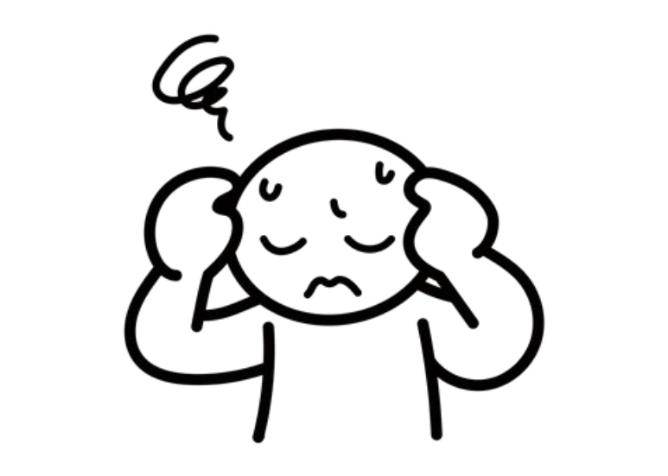
Problem
I want to play the Fifteen Puzzle game online with images that make me enjoy the game more.
While there are multiple Fifteen Puzzle games online, none of them have the option to use images that my group and I are familiar with. I want a Fifteen Puzzle game where I can solve familiar images.

Slide 3
Introduction
Our goal with this project was to create a functional and stylish game online implementation of the Fifteen Puzzle Game using only HTML, CSS, and JavaScript. Players will start on a home screen that simply explains the rules and will then proceed to the game screen. On the game screen, they’ll be met with the puzzle board which has a unique background image, along with a settings button and a shuffle button. The settings button allows the user to choose between multiple background images as well as change the theme of the game while the shuffle button shuffles the puzzle grid.

Slide 4
Goals
To equally distribute the workload amongst our team and coordinate progress using the Scrum methodology.
To have a functioning game experience for the user with unique features
Use HTML to create the webpage which allows the user to interact with different buttons and the puzzle grid itself.
Uses JavaScript to implement the game's functionality by managing DOM interactions, game states, and event listeners to create a tile-based puzzle game, enabling actions like shuffling tiles, selecting images, and toggling screens based on player interactions.
Uses CSS to enhance the visual flare of the game as well as allow the user stylistic freedom with the choice of three themes.

Slide 5
Scrum Methodology
DATE | TIME | SUBJECT | Topic 1 | Topic 2 | Topic 3
11/23/24 | 15 minutes | First Meeting | Deciding Roles | Figuring out Timeline | Finished Proposal
11/25/24 | 40 minutes | Setting Goals | Conducted Research | Addressed Concerns | Assigned Coding Tasks
11/28/24 | 40 minutes | Checkup | Shared Progress | Shared Concerns | Assigned New Tasks
11/30/24 | 2 hours | Implementation | Tested Base Game | Added Extra Features | Refined Styling
12/02/24 | 2 hours | Final Meeting | Tested Complete Project | Finalized Presentation Slides | Recorded Presentation
Scrum allowed us to be organized and efficient. The method overall helped us complete our project without stress and anxiety.

Slide 6
DEMO: https://codd.cs.gsu.edu/~ykarim1/FifteenPuzzleProject/fifteenpuzzle.html

Slide 7
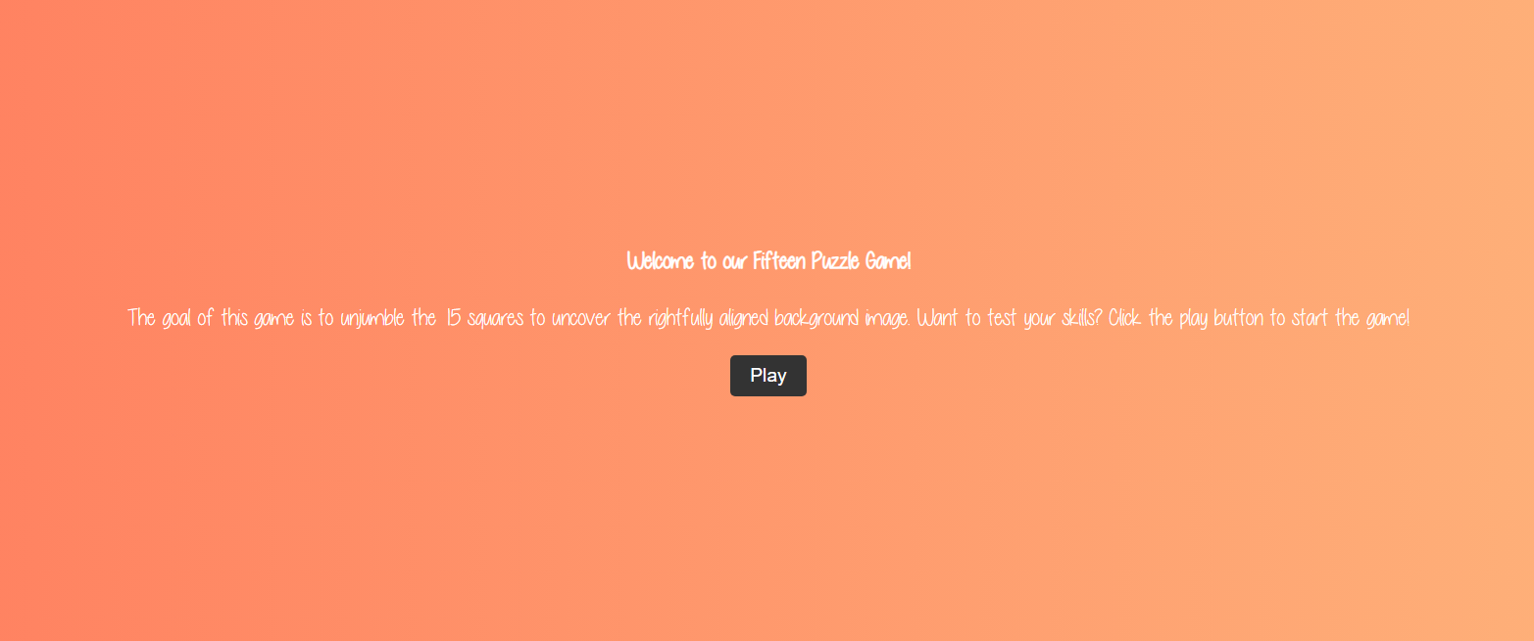
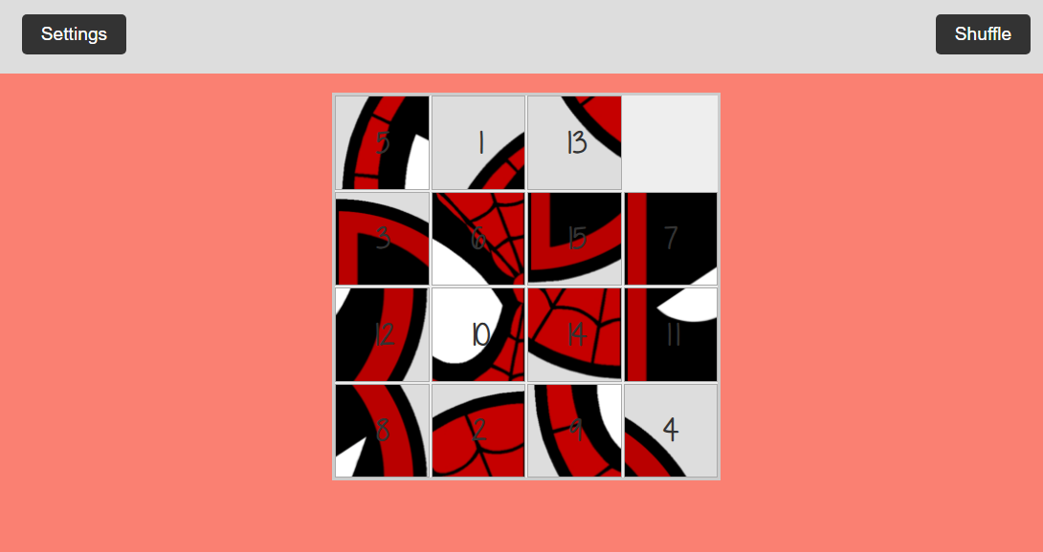
How?

Slide 8
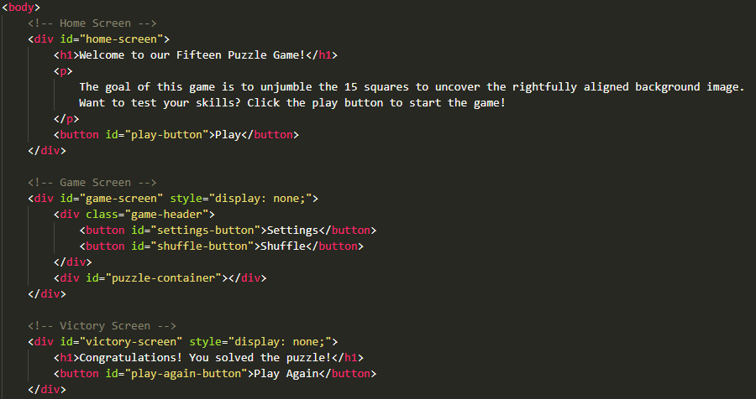
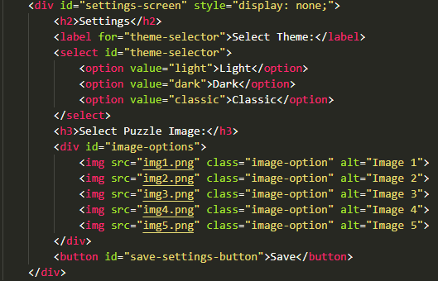
Fifteenpuzzle.html
This is the HTML code that runs the webpage for our game.
It uses DIVS to organize the screens and buttons to allow the user to interact with each page.
This page is more about setting up the references to the JS page in order to allow for proper implementation and user accessibility of every feature.

Slide 9
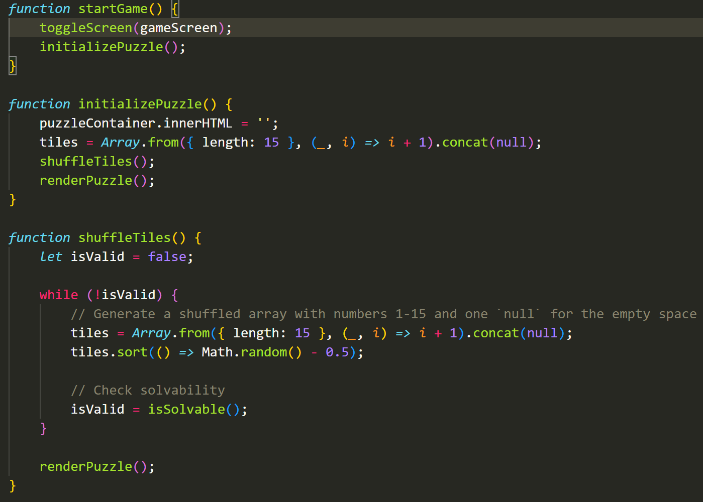
Fifteenpuzzle.js
This is the beginning of the JavaScript Code.
Recursion is used extensively in this code to allow the code to use its own methods to help itself accomplish complex task.
For example, initializePuzzle() references both shuffleTiles() and renderPuzzle() in order to properly start the game.

Slide 10
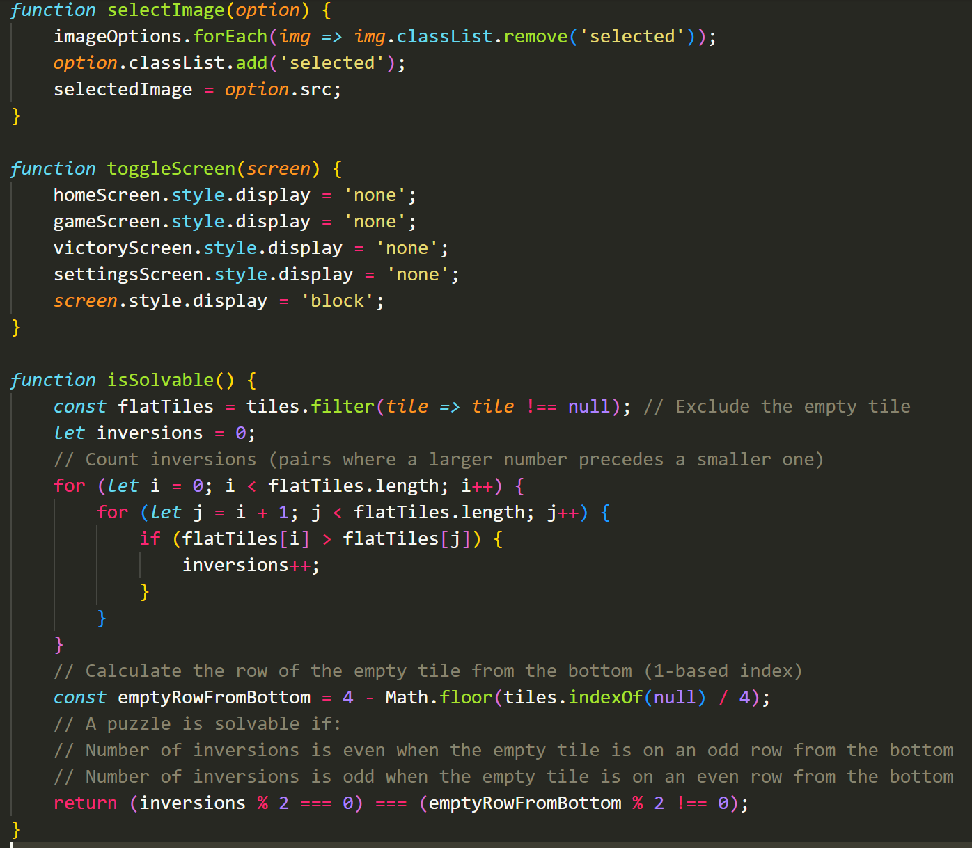
Fifteenpuzzle.js
The method isSolvable is used to make sure the user isn’t given an impossible puzzle.
On the previous slide, shuffleTiles() references isSolvable() to make sure that the puzzle is possible before rendering it.

Slide 11

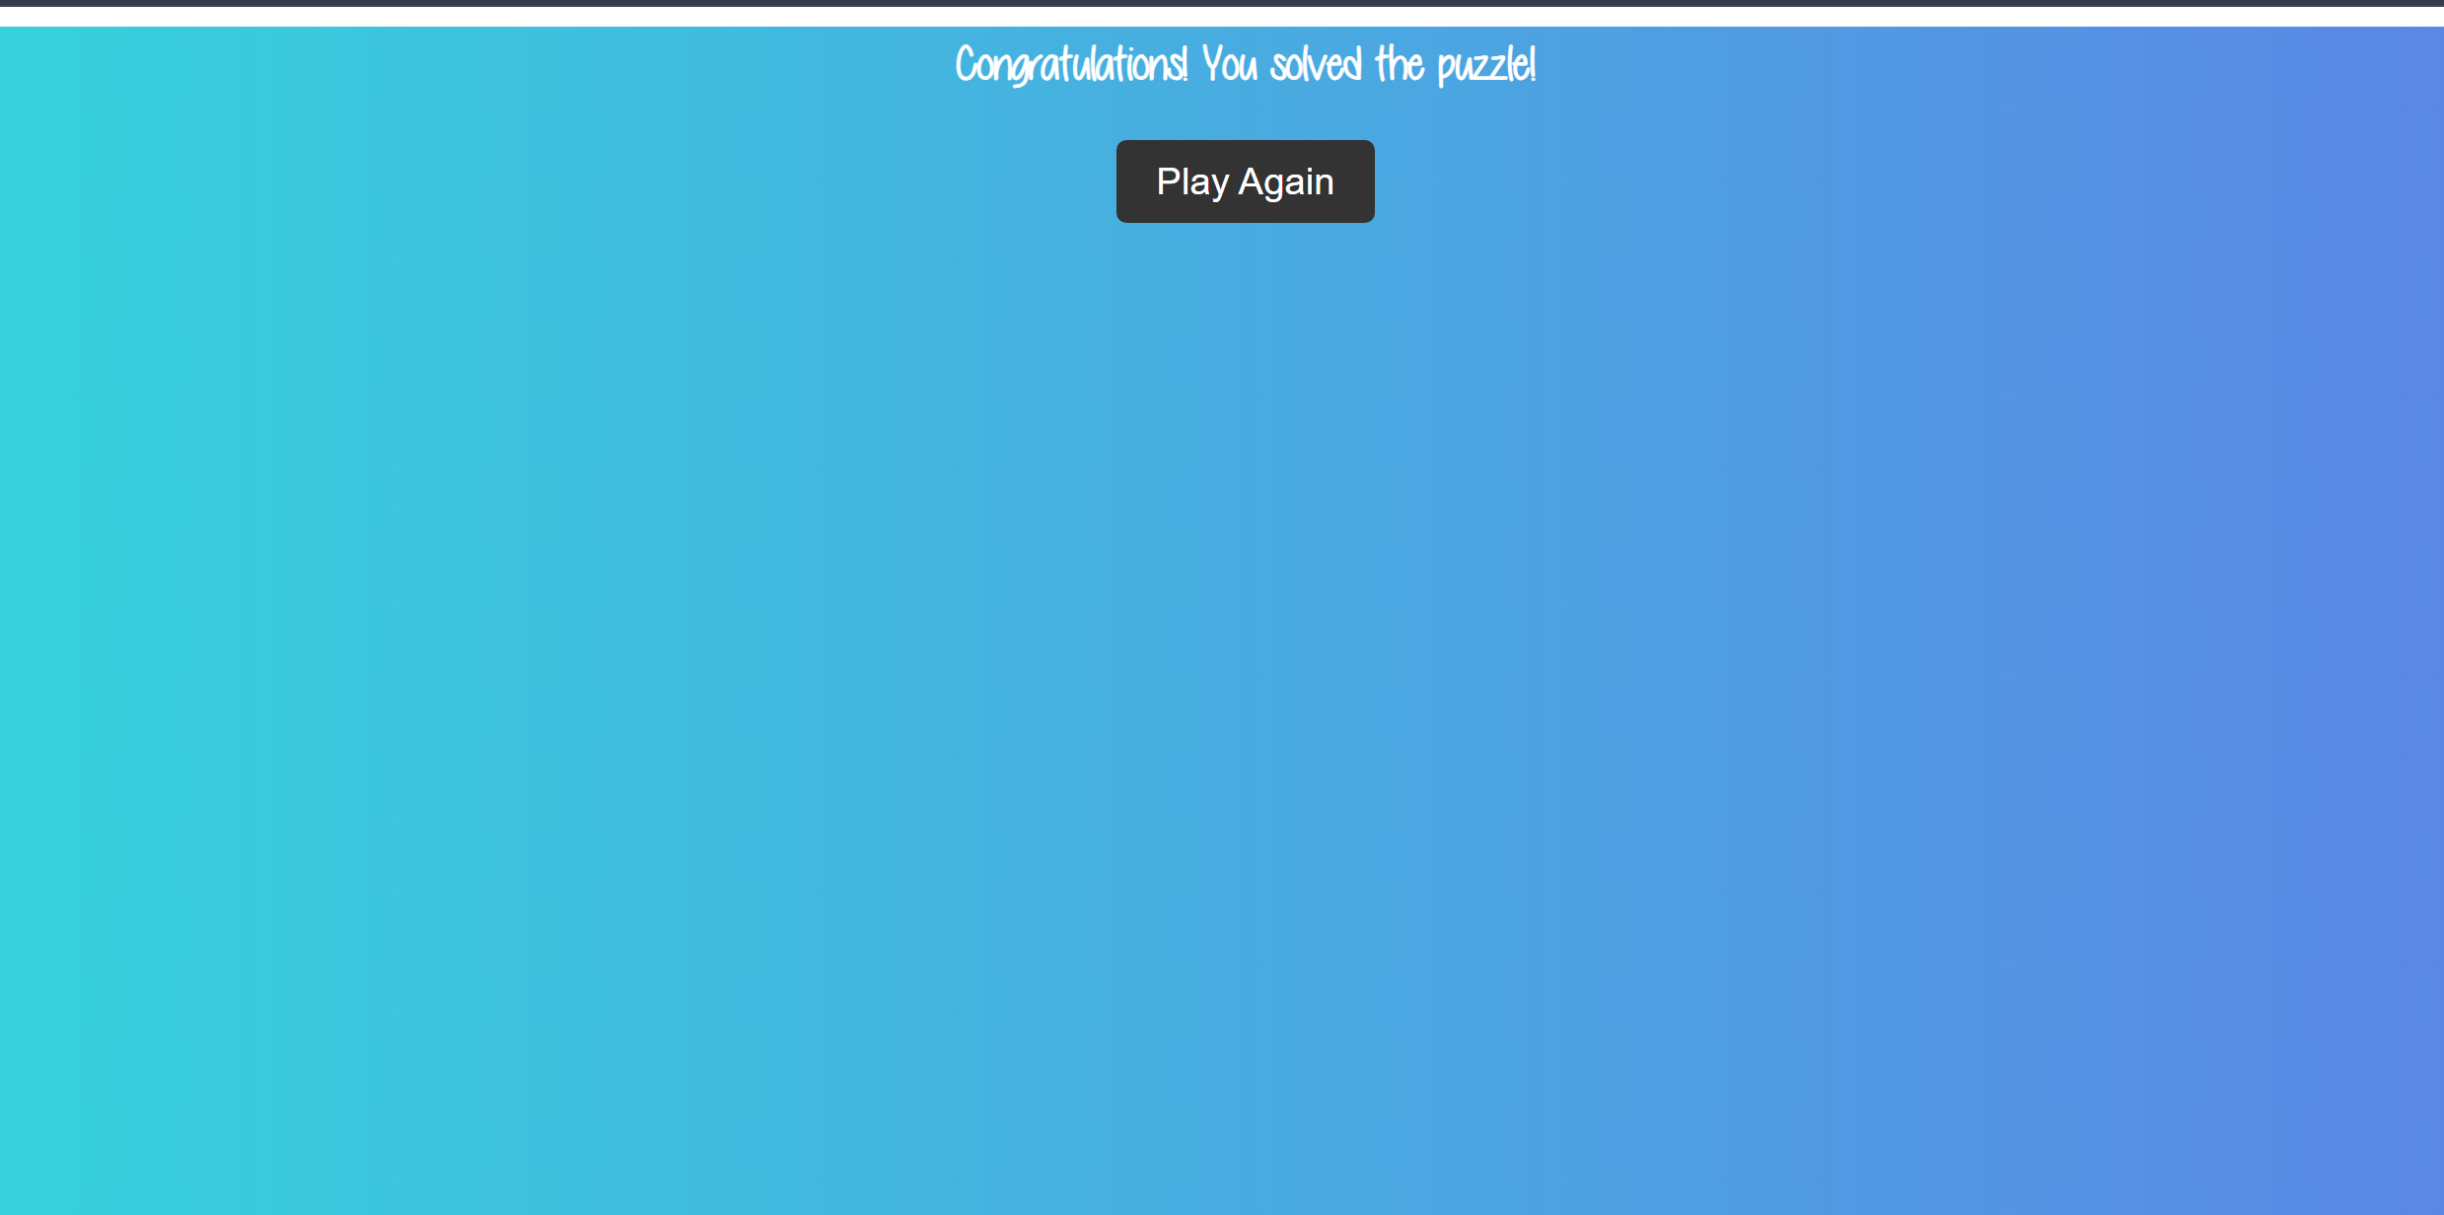
Extra Features
Multiple Background Images
End of Game Notification

Slide 12
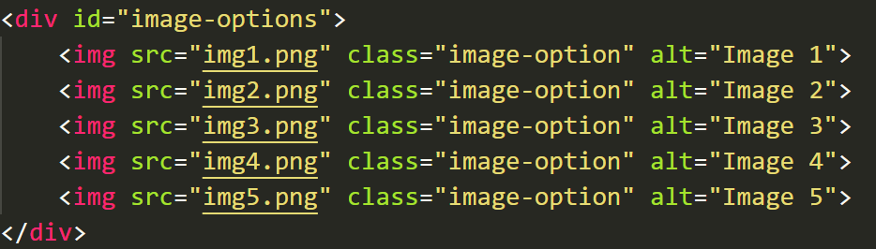
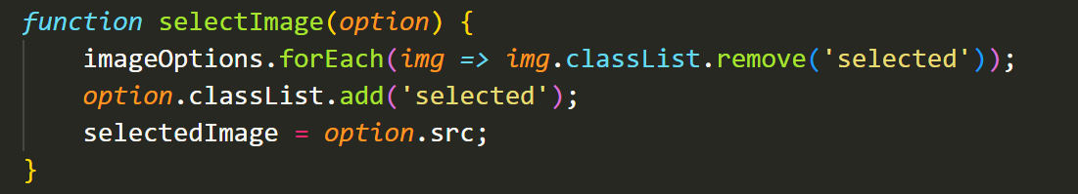
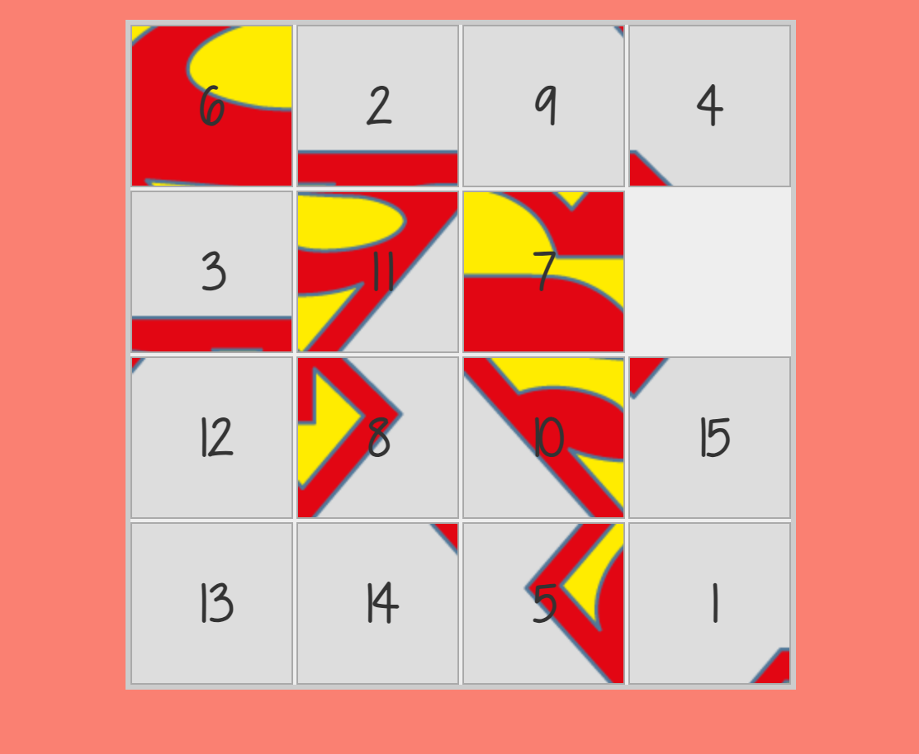
Multiple backgrounds

Slide 13
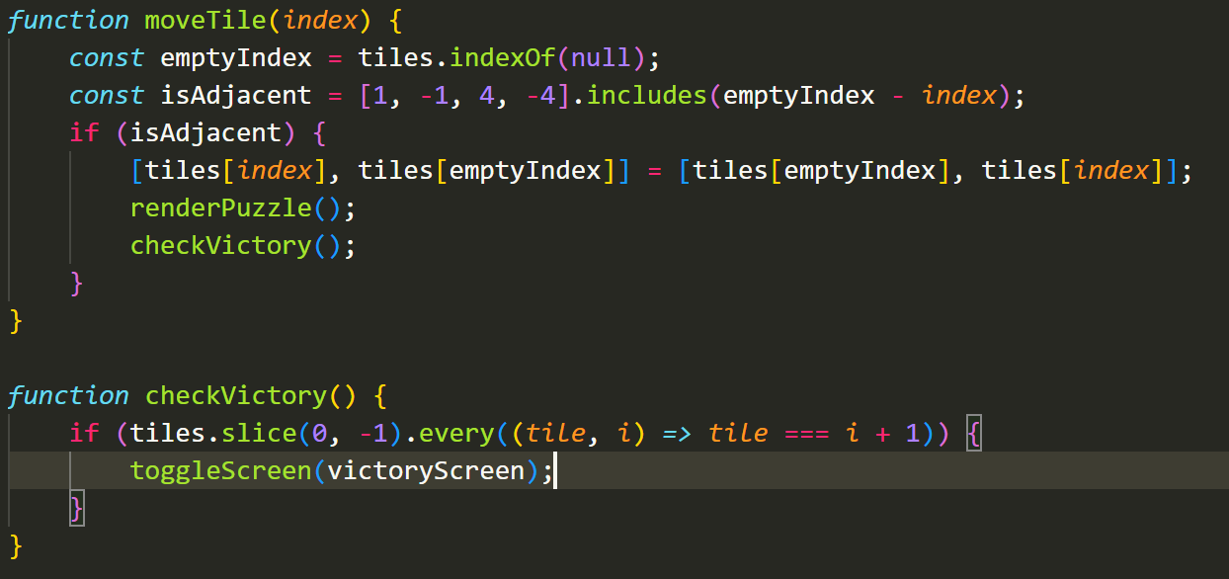
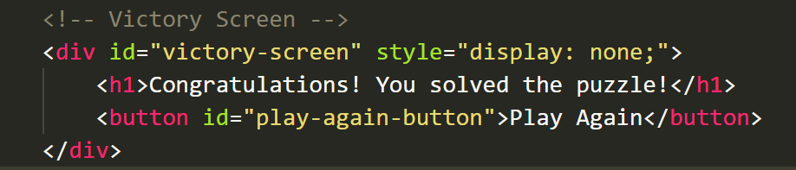
Victory Screen

Slide 14
Features to be implemented Later
Add more images
Add more themes
Add more puzzles

Slide 15
Thank you!

